Slide 1
Lecture 02 – Part C Game Playing: Adversarial Search
Dr. Shazzad Hosain
Department of EECS
North South Universtiy
shazzad@northsouth.edu
Notes:
‹#›

Slide 2
Outline
- Game Playing: Adversarial Search
- Minimax Algorithm
- α-β Pruning Algorithm
- Games of chance
- State of the art

Slide 3
Game Playing: Adversarial Search
Introduction
So far, in problem solving, single agent search
The machine is “exploring” the search space by itself.
No opponents or collaborators.
Games require generally multiagent (MA) environments:
Any given agent need to consider the actions of the other agent and to know how do they affect its success?
Distinction should be made between cooperative and competitive MA environments.
Competitive environments: give rise to adversarial search: playing a game with an opponent.

Slide 4
Game Playing: Adversarial Search
Introduction
Why study games?
Game playing is fun and is also an interesting meeting point for human and computational intelligence.
They are hard.
Easy to represent.
Agents are restricted to small number of actions.
Interesting question:
Does winning a game absolutely require human intelligence?

Slide 5
Game Playing: Adversarial Search
Introduction
Different kinds of games:
 | Deterministic | Chance
Perfect Information | Chess, Checkers Go, Othello | Backgammon, Monopoly
Imperfect Information | Battleship | Bridge, Poker, Scrabble,
Games with perfect information. No randomness is involved.
Games with imperfect information. Random factors are part of the game.

Slide 6
Searching in a two player game
Traditional (single agent) search methods only consider how close the agent is to the goal state (e.g. best first search).
In two player games, decisions of both agents have to be taken into account: a decision made by one agent will affect the resulting search space that the other agent would need to explore.
Question: Do we have randomness here since the decision made by the opponent is NOT known in advance?
☺ No. Not if all the moves or choices that the opponent can make are finite and can be known in advance.

Slide 7
Searching in a two player game
To formalize a two player game as a search problem an agent can be called MAX and the opponent can be called MIN.
Problem Formulation:
Initial state: board configurations and the player to move.
Successor function: list of pairs (move, state) specifying legal moves and their resulting states. (moves + initial state = game tree)
A terminal test: decide if the game has finished.
A utility function: produces a numerical value for (only) the terminal states. Example: In chess, outcome = win/loss/draw, with values +1, -1, 0 respectively.
Players need search tree to determine next move.

Slide 8
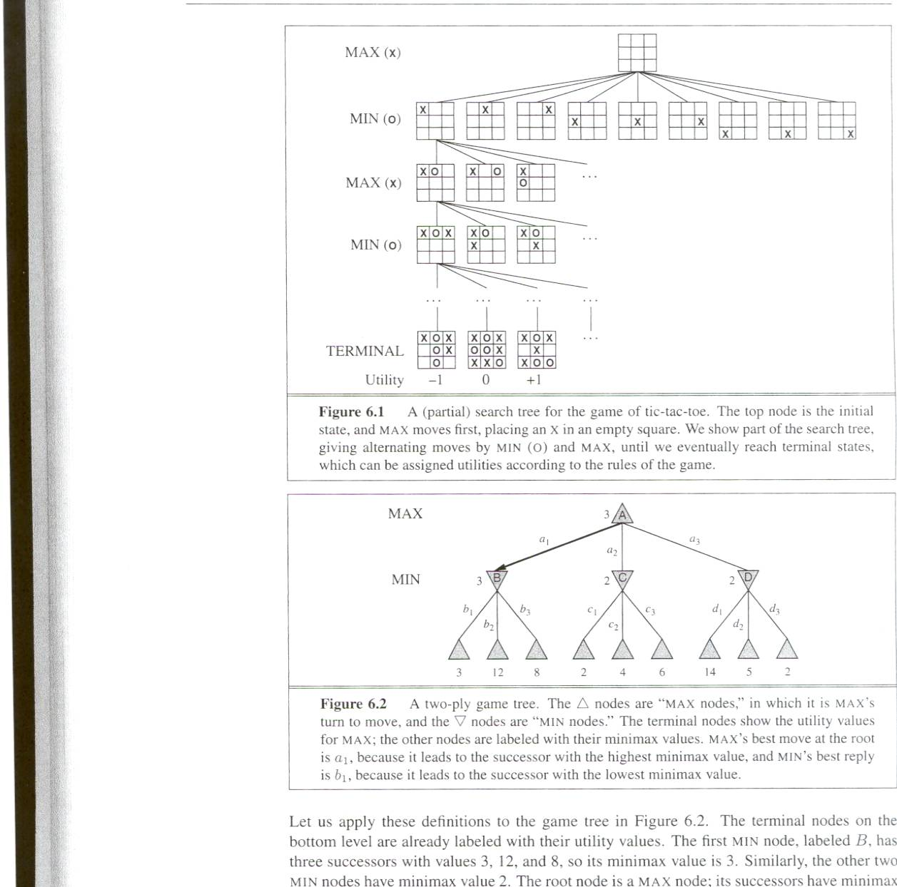
Partial game tree for Tic-Tac-Toe
Each level of search nodes in the tree corresponds to all possible board configurations for a particular player MAX or MIN.
Utility values found at the end can be returned back to their parent nodes.
Idea: MAX chooses the board with the max utility value, MIN the minimum.

Slide 9
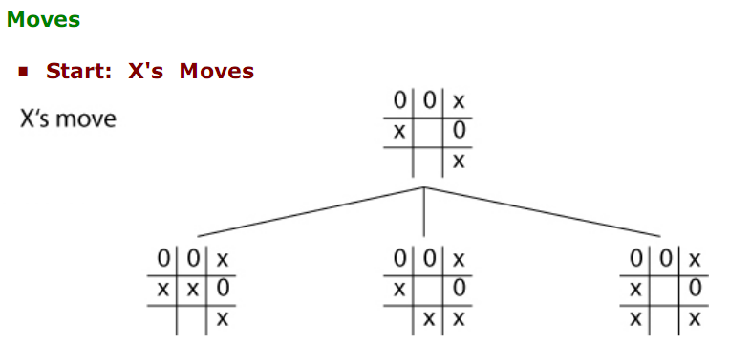
Partial game tree for Tic-Tac-Toe

Slide 10
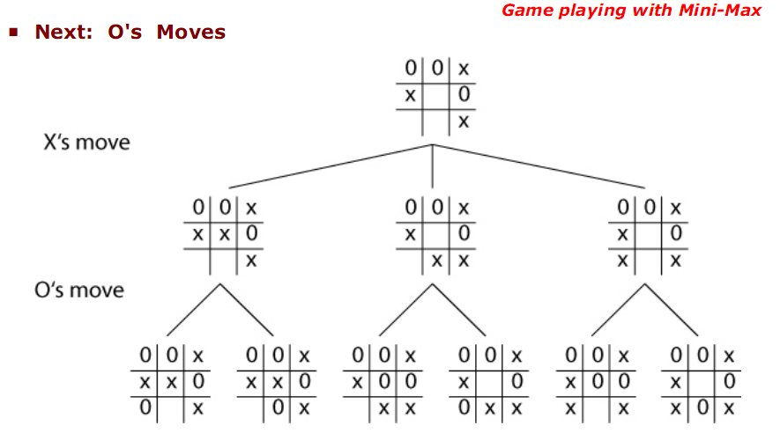
Partial game tree for Tic-Tac-Toe

Slide 11
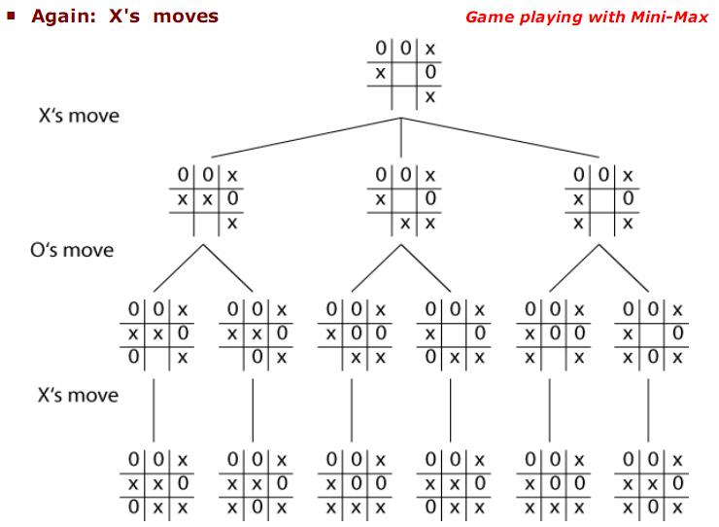
Partial game tree for Tic-Tac-Toe

Slide 12
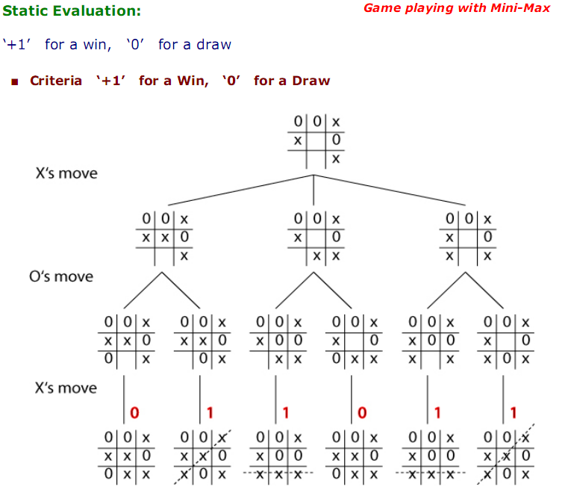
Partial game tree for Tic-Tac-Toe

Slide 13
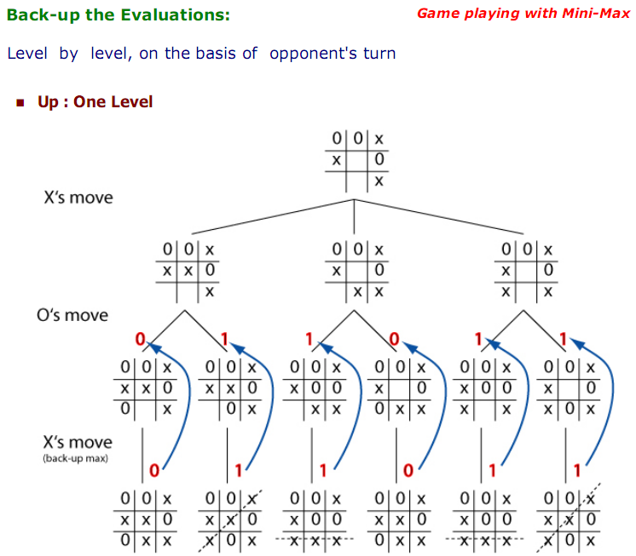

Slide 14
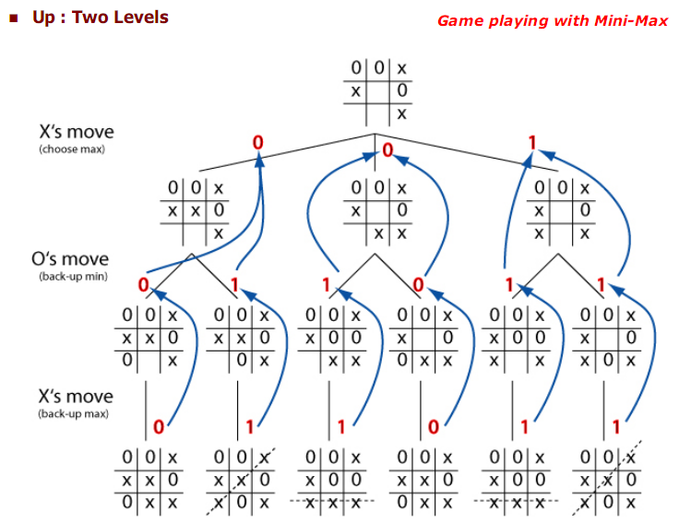

Slide 15
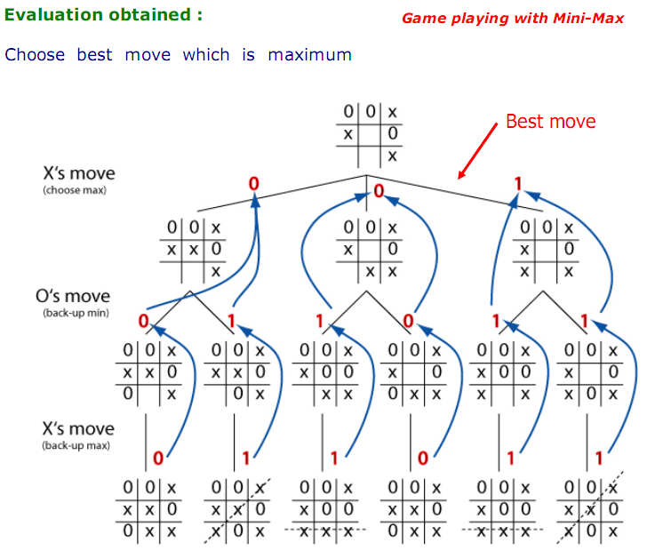

Slide 16
Searching in a two player game
The search space in game playing is potentially very huge: Need for optimal strategies.
The goal is to find the sequence of moves that will lead to the winning for MAX.
How to find the best trategy for MAX assuming that MIN is an infaillible opponent.
Given a game tree, the optimal strategy can be determined by the MINIMAX-VALUE for each node. It returns:
Utility value of n if n is the terminal state.
Maximum of the utility values of all the successor nodes s of n : n is a MAX’s current node.
Minimum of the utility values of the successor node s of n : n is a MIN’s current node.

Slide 17
Minimax Algorithm
Minimax algorithm
Perfect for deterministic, 2-player game
One opponent tries to maximize score (Max)
One opponent tries to minimize score (Min)
Goal: move to position of highest minimax value
Identify best achievable payoff against best play

Slide 18
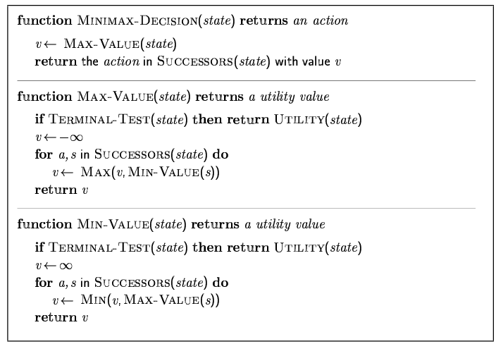
Minimax Algorithm (cont’d)

Slide 19
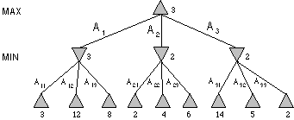
Minimax Algorithm (cont’d)
Max node
Min node
MAX node
MIN node
value computed
by minimax
Utility value

Slide 20
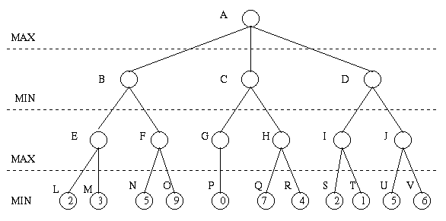
Minimax Algorithm (cont’d)

Slide 21
Minimax Algorithm (cont’d)
3
9
0
7
2
6

Slide 22
Minimax Algorithm (cont’d)
3
0
2
3
9
0
7
2
6

Slide 23
Minimax Algorithm (cont’d)
3
3
0
2
3
9
0
7
2
6

Slide 24
Minimax Algorithm (cont’d)
Properties of minimax algorithm:
Complete? Yes (if tree is finite)
Optimal? Yes (against an optimal opponent)
Time complexity? O(b^{m})
Space complexity? O(bm) (depth-first exploration)
Note: For chess, b = 35, m = 100 for a “reasonable game.”
Solution is completely infeasible
Actually only 10⁴⁰ board positions, not 35¹⁰⁰

Slide 25
Minimax Algorithm (cont’d)
Limitations
Not always feasible to traverse entire tree
Time limitations
Improvements
Depth-first search improves speed
Use evaluation function instead of utility
Evaluation function provides estimate of utility at given position

Slide 26
Problem of Minimax search
Number of games states is exponential to the number of moves.
Solution: Do not examine every node
==> Alpha-beta pruning
Alpha = value of best choice found so far at any choice point along the MAX path.
Beta = value of best choice found so far at any choice point along the MIN path.
☺

Slide 27
Alpha-beta Game Playing
Basic idea:
If you have an idea that is surely bad, don't take the time to see how truly awful it is.” -- Pat Winston
Some branches will never be played by rational players since
they include sub-optimal decisions (for either player).
>=2
We don’t need to compute the value at this node.
No matter what it is, it can’t effect the value of the root node.
=2
<=1
2
7
1
?

Slide 28
α-β Pruning Algorithm
Principle
If a move is determined worse than another move already examined, then further examination deemed pointless

Slide 29
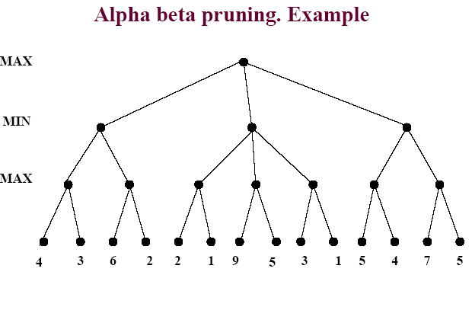

Slide 30
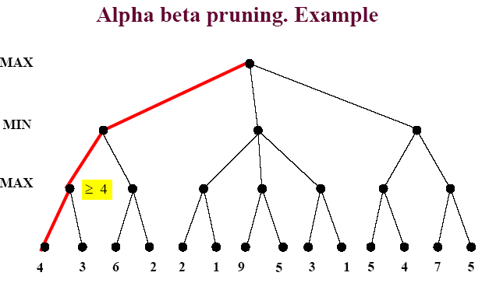
Game Playing: Adversarial Search

Slide 31
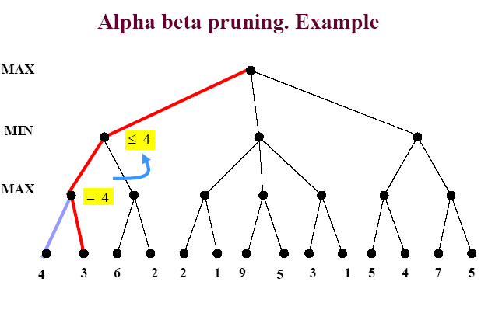
Game Playing: Adversarial Search

Slide 32
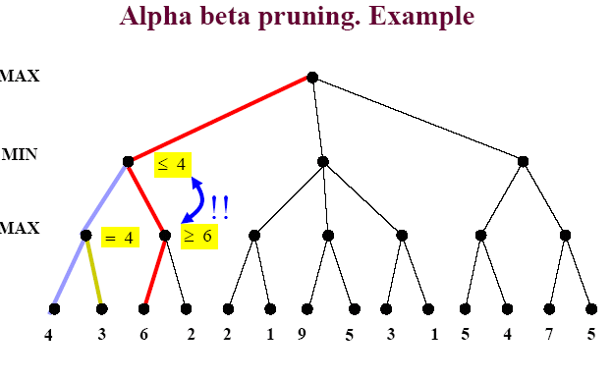
Game Playing: Adversarial Search

Slide 33
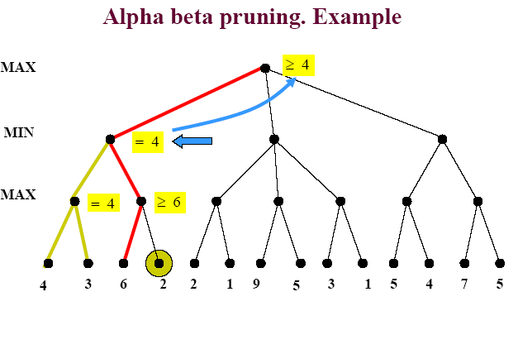
Game Playing: Adversarial Search

Slide 34
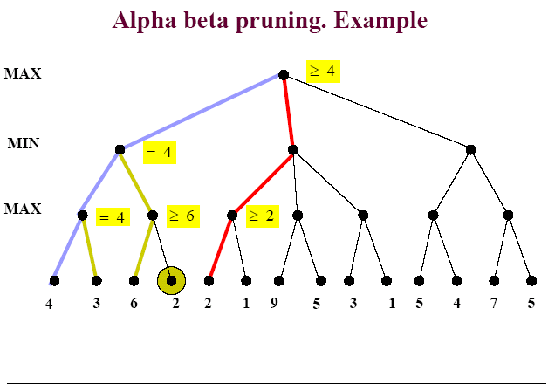
Game Playing: Adversarial Search

Slide 35
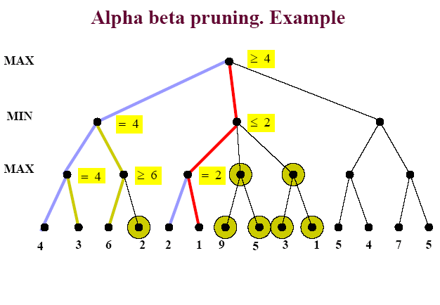
Game Playing: Adversarial Search

Slide 36
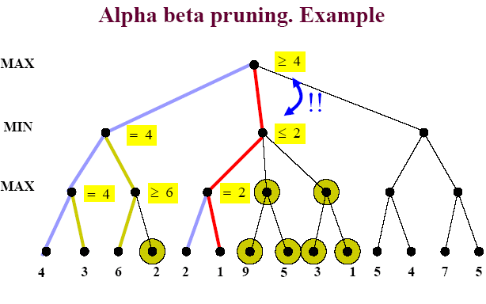
Game Playing: Adversarial Search

Slide 37
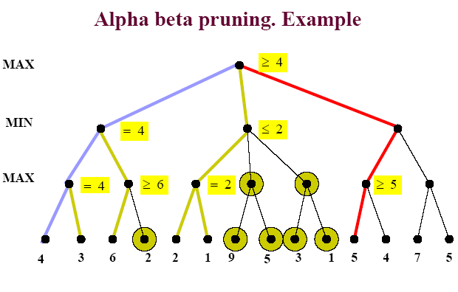
Game Playing: Adversarial Search

Slide 38
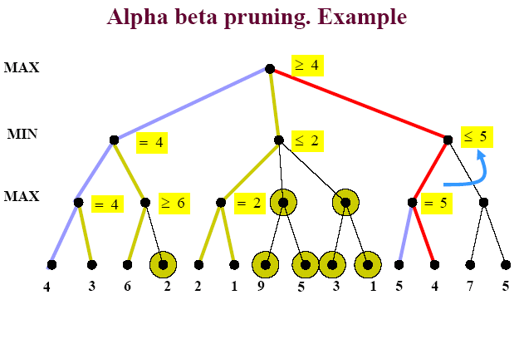
Game Playing: Adversarial Search

Slide 39
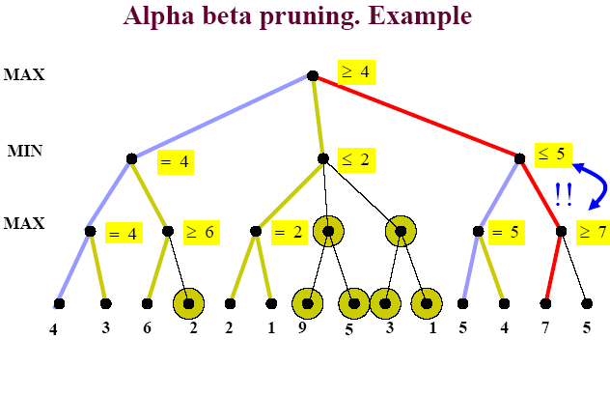
Game Playing: Adversarial Search

Slide 40
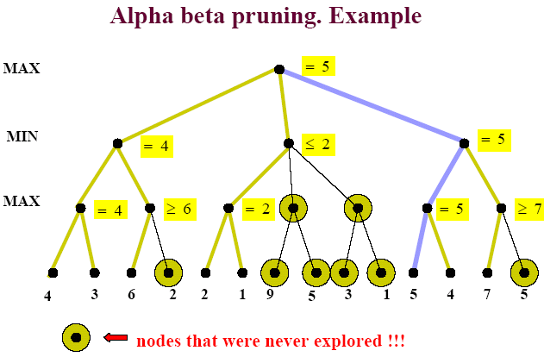
Game Playing: Adversarial Search

Slide 41
Alpha-Beta Pruning (αβ prune)
Rules of Thumb
α is the highest max found so far
β is the lowest min value found so far
If Min is on top Alpha prune
If Max is on top Beta prune
You will only have alpha prune’s at Min level
You will only have beta prunes at Max level

Slide 42
Properties of α-β Prune
Pruning does not affect final result
Effectiveness highly depends on order in which the states are examined
Good move ordering improves effectiveness of pruning
With "perfect ordering," time complexity = O(b^{m/2})
🡪 doubles depth of search

Slide 43
General description of α-β pruning algorithm
Traverse the search tree in depth-first order
At each Max node n, alpha(n) = maximum value found so far
Start with - infinity and only increase.
Increases if a child of n returns a value greater than the current alpha.
Serve as a tentative lower bound of the final pay-off.
At each Min node n, beta(n) = minimum value found so far
Start with infinity and only decrease.
Decreases if a child of n returns a value less than the current beta.
Serve as a tentative upper bound of the final pay-off.
beta(n) for MAX node n: smallest beta value of its MIN ancestors.
alpha(n) for MIN node n: greatest alpha value of its MAX ancestors

Slide 44
General description of α-β pruning algorithm
Carry alpha and beta values down during search
alpha can be changed only at MAX nodes
beta can be changed only at MIN nodes
Pruning occurs whenever alpha >= beta
alpha cutoff:
Given a Max node n, cutoff the search below n (i.e., don't generate any more of n's children) if alpha(n) >= beta(n)
(alpha increases and passes beta from below)
beta cutoff:
Given a Min node n, cutoff the search below n (i.e., don't generate any more of n's children) if beta(n) <= alpha(n)
(beta decreases and passes alpha from above)

Slide 45
α-β Pruning Algorithm
function ALPHA-BETA-SEARCH(state) returns an action
inputs: state, current state in game
v← MAX-VALUE(state, - ∞ , +∞)
return the action in SUCCESSORS(state) with value v
function MAX-value (n, alpha, beta) return utility value
if n is a leaf node then return f(n);
for each child n’ of n do
alpha :=max{alpha, MIN-value(n’, alpha, beta)};
if alpha >= beta then return beta /* pruning */
end{do}
return alpha
function MIN-value (n, alpha, beta) return utility value
if n is a leaf node then return f(n);
for each child n’ of n do
beta :=min{beta, MAX-value(n’, alpha, beta)};
if beta <= alpha then return alpha /* pruning */
end{do}
return beta

Slide 46
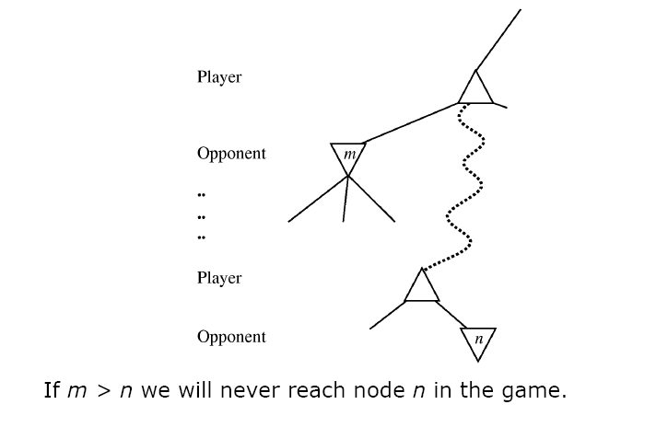
Game Playing: Adversarial Search
In another way

Slide 47
Evaluating Alpha-Beta algorithm
Alpha-Beta is guaranteed to compute the same value for the root node as computed by Minimax.
Worst case: NO pruning, examining O(b^{d}) leaf nodes, where each node has b children and a d-ply search is performed
Best case: examine only O(b^{d/2}) leaf nodes. You can search twice as deep as Minimax! Or the branch factor is b^{1/2} rather than b.
Best case is when each player's best move is the leftmost alternative, i.e. at MAX nodes the child with the largest value generated first, and at MIN nodes the child with the smallest value generated first.
In Deep Blue, they found empirically that Alpha-Beta pruning meant that the average branching factor at each node was about 6 instead of about 35-40

Slide 48
Evaluation Function
Evaluation function
Performed at search cutoff point
Must have same terminal/goal states as utility function
Tradeoff between accuracy and time → reasonable complexity
Accurate
Performance of game-playing system dependent on accuracy/goodness of evaluation
Evaluation of nonterminal states strongly correlated with actual chances of winning

Slide 49
Evaluation functions
For chess, typically linear weighted sum of features
Eval(s) = w₁ f₁(s) + w₂ f₂(s) + … + w_{n} f_{n}(s)
e.g., w₁ = 9 with
f₁(s) = (number of white queens) – (number of black queens), etc.
Key challenge – find a good evaluation function:
Isolated pawns are bad.
How well protected is your king?
How much maneuverability to you have?
Do you control the center of the board?
Strategies change as the game proceeds

Slide 50
References
Chapter 5 of “Artificial Intelligence: A modern approach” by Stuart Russell, Peter Norvig.
Chapter 6 of “Artificial Intelligence Illuminated” by Ben Coppin

